Slide 1

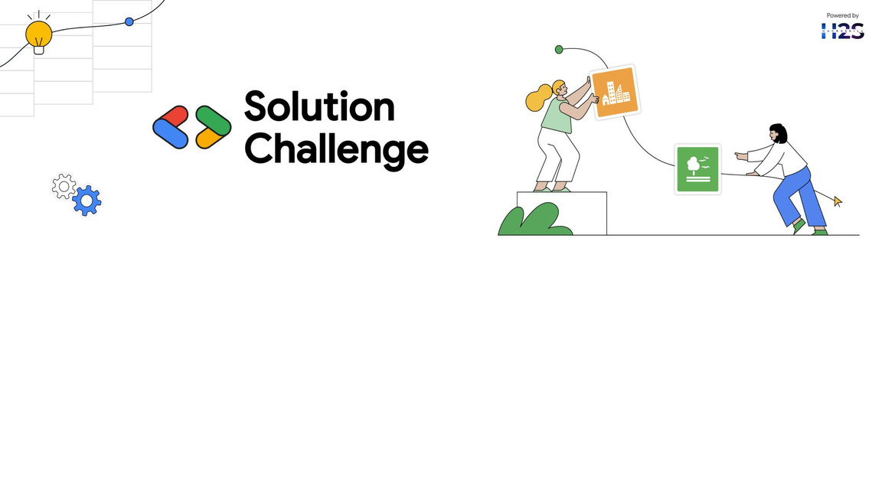
Team Name:
The Ideation Crew
Team Leader Name:
Jatin Sharma
Problem Statement:
Traditional cattle farming faces challenges in early disease detection, herd monitoring, leading to productivity losses and high veterinary costs.

Slide 2

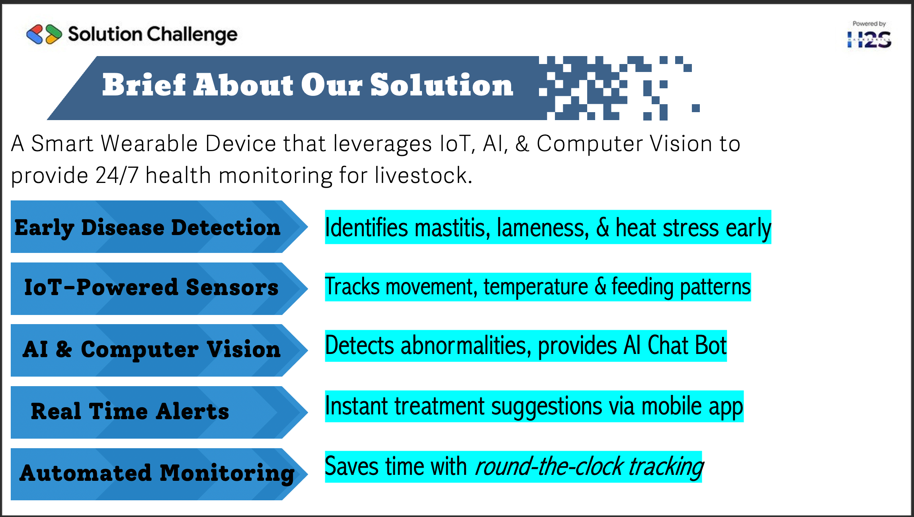
Brief About Our Solution
A Smart Wearable Device which send data to cloud which is accessible through our website/mobile application. Features of our device:-
Identifies mastitis, lameness &heat stress before symptoms worsen
Early Disease Detection
IoT-Powered Sensors
Tracks movements, temperature & feeding patterns
Analyzes health data and detects abnormalities
Also our app provides AI Chat Bot with voice search
AI & Computer Vision
Real Time Alerts
Mobile app sends alerts and treatment suggestions
Automated Monitoring
Saves time and labor with 24/7 tracking
Notes:
2

Slide 3
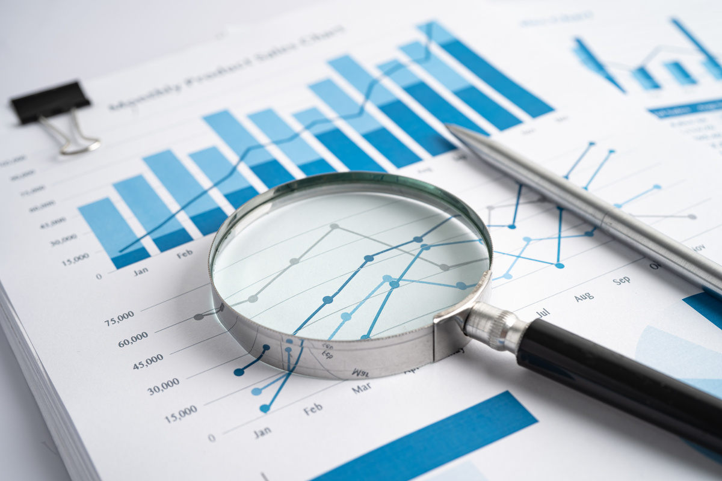
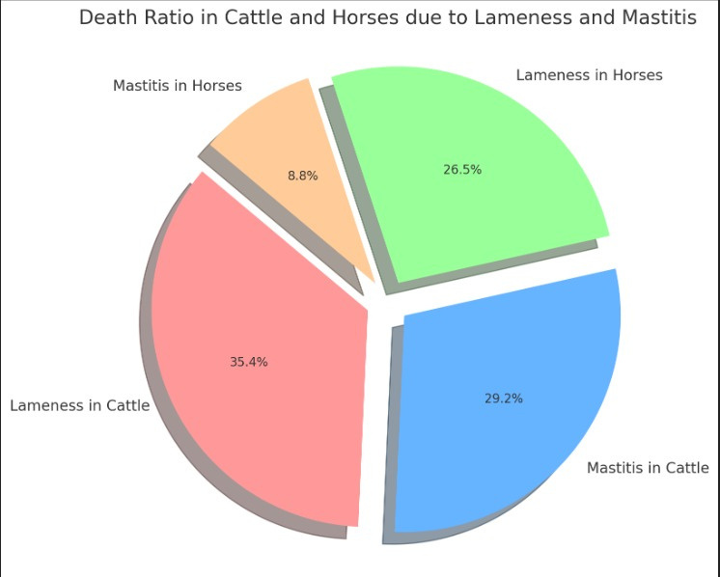




Mortality Rate
Lameness in
Horses
Mastitis in
Cattle
Lameness in
Cattle
Mastitis in
Horses
Source: https://www.thecattlesite.com
Notes:
2

Slide 4




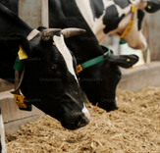


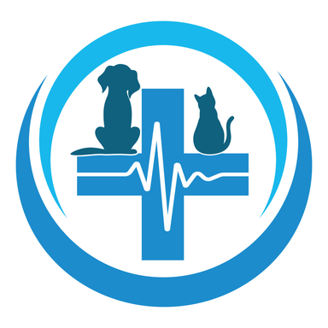
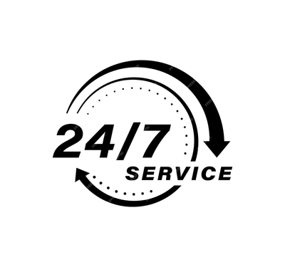

Why Best From Others
Features
Our AI-Powered System
Others (JioGauSamriddhi)
Animal Coverage
Only for Cows
Supports multiple livestock
(cows, buffaloes, horses etc.)
Health Monitoring
Basic disease
tracking
IoT & AI-based predictive
detection
Feeding System
No nutrition
optimization
Smart feeding to prevent
diseases
Doctor connectivity
Nearby vet directory
& chat Support
No vet database
AI Chatbot
No AI assistance
Instant AI assistance
Notes:
2

Slide 5
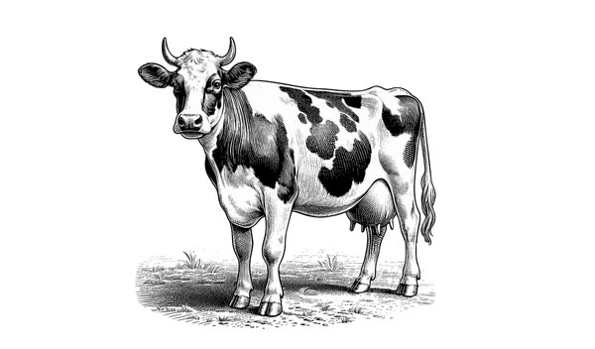



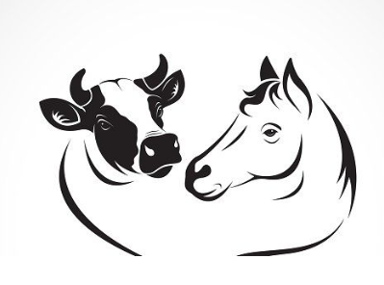
Key Features Of Solution
Computer Vision for Lameness Detection
AI ChatBot
Smart Feeding System
IoT Wearable Sensors
Availability of Veterinarian
& near-by Pharmacist
AI-Powered Mastitis Detection

Slide 6
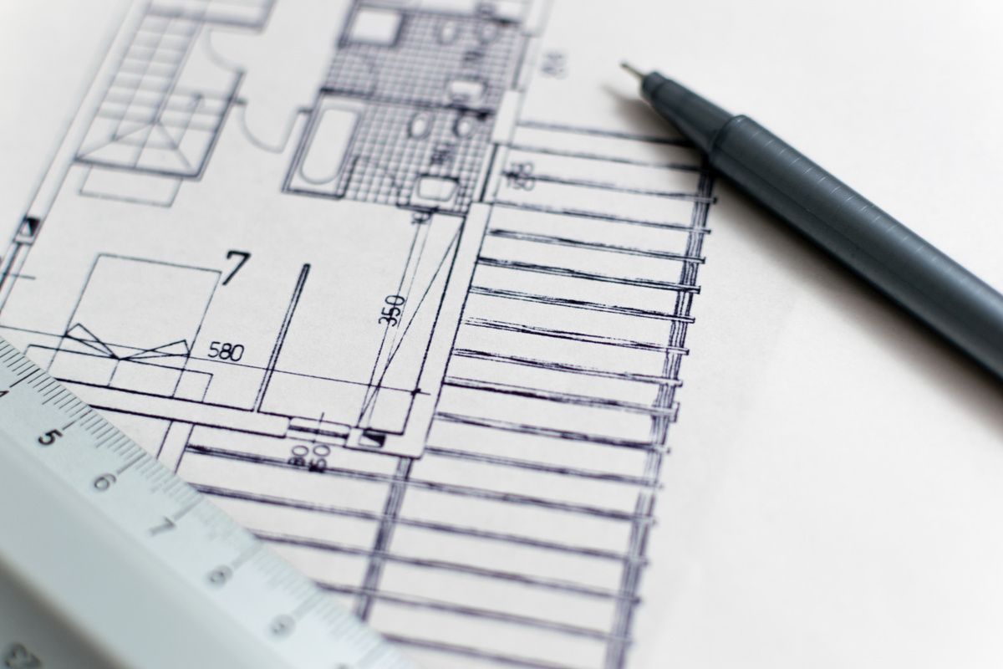
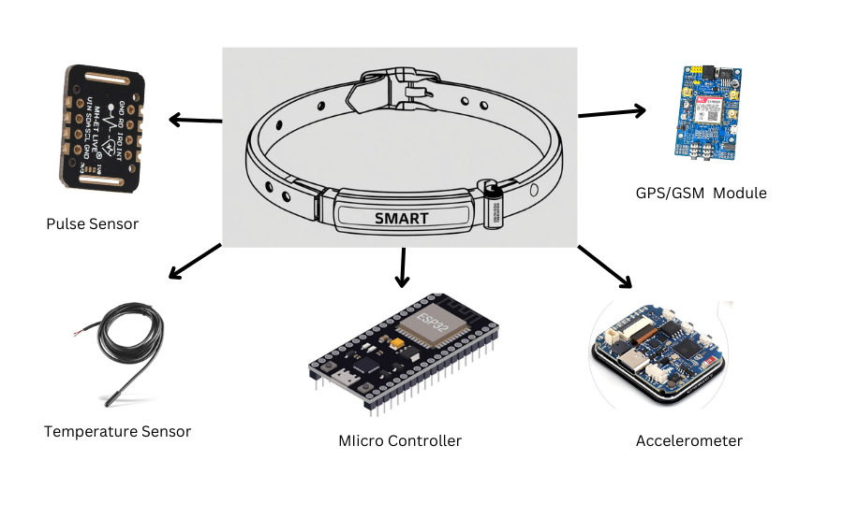
Architecture Diagram

Slide 7
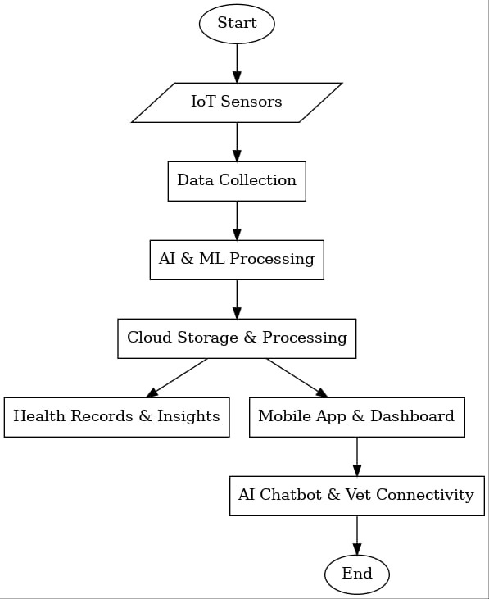







Use-Case Diagram

Slide 8
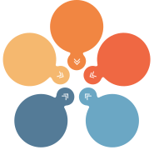




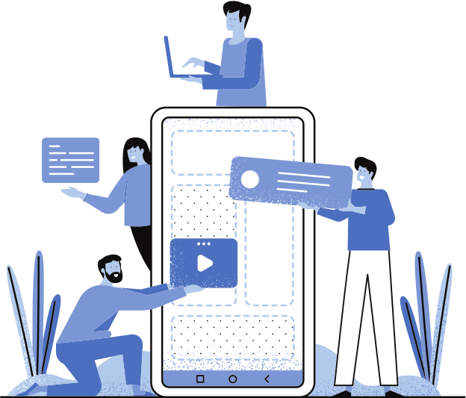
Technologies Used
IoT & Hardware
AI & Machine Learning
Cloud & Big Data
Mobile & Web Apps
GPS Tracking

Slide 9
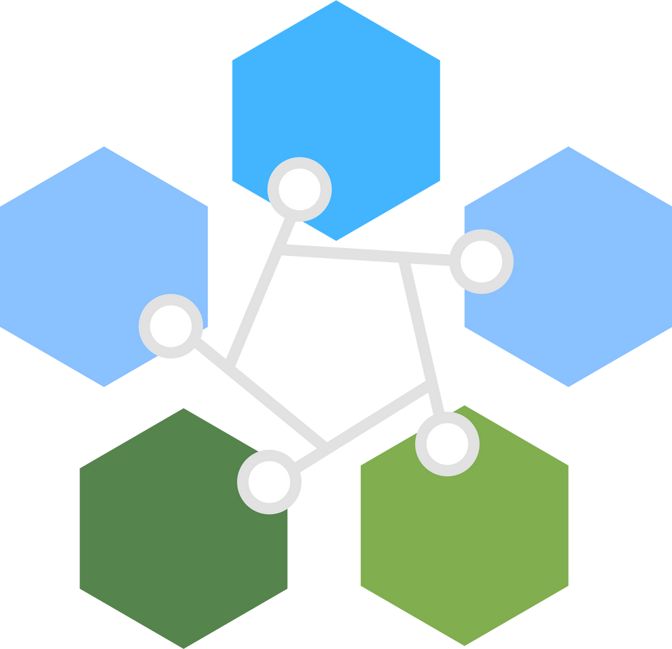

To create *MVP snapshots, you'll need **UI mockups* or *prototype screenshots* for the following key components:
### *1. Dashboard (Web & Mobile App)*
📌 *Real-time cow health status* (temperature, movement, feeding)
📌 *Disease alerts & notifications* (mastitis, lameness, heat stress)
📌 *Farm analytics & reports*
### *2. AI-Driven Disease Detection System*
📌 *Gait analysis (Computer Vision output for lameness detection)*
📌 *Predictive analytics dashboard (early disease warning system)*
### *3. Smart Feeding System Interface*
📌 *Customized diet recommendations based on cow health data*
Would you like *UI wireframes* or a *prototype demo* for your MVP? 🚀
Future Development
Scalability
& Expansion
Grow to more regions & species
AI&Iot
Integration
Cloud &
Data
Insights
Real-time analytics for
higher productivity.
Smart Analytics & Automation
Instant support & Guidance
AI chat
bot & Vet Connectivity
Reduces vet expenses, increases milk yield
Sustainable
&
Cost-Effective

Slide 10
